Slide 1
OS
Manish Ranjan Behera

Slide 3
What is UNIX, GNU and LINUX?
Unix is a computer Operating System which is capable of handling activities from multiple users at the same time. The development of Unix started around 1969 at AT&T Bell Labs by Ken Thompson and Dennis Ritchie. Unix is not free. Unix OS made up of -
1. Kernel - is central component of an operating system that manages operations of computer and hardware.
2. Shell - is a computer program that presents a command line interface which allows you to control your computer using commands entered with a keyboard.

Slide 4
Why was GNU/Linux developed?
An operating system works as the interface between the user and hardware. It is a major component that ensures the proper functioning of the entire computer system.
UNIX is an operating system, but it was expensive.
Therefore, the Free Software Foundation developed GNU operating system with a lot of free software. Linux is the combination of GNU software and Linux kernel.

Slide 5
Difference between GNU and Linux
The main difference between GNU and Linux is that GNU is an OS designed as a replacement for UNIX with many software programs while Linux is an operating system with a combination of GNU software and Linux kernel.
Linux is the kernel: the program in the system that allocates the machine's resources to the other programs that you run. The kernel is an essential part of an operating system, but useless by itself; it can only function in the context of a complete operating system.
Linux is normally used in combination with the GNU operating system: the whole system is basically GNU with Linux added, or GNU/Linux

Slide 6
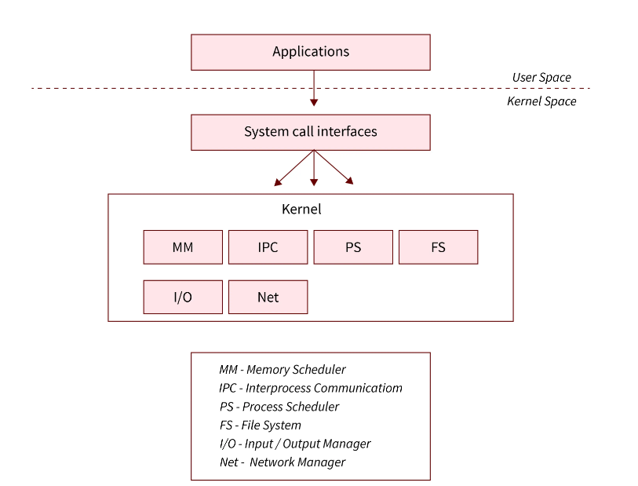
Linux Features
Monolithic architecture
In monolithic architecture, each component of the operating system is contained in the kernel i.e. it is working in kernel space, and the components of the operating system communicate with each other using function calls.

Slide 7
Preemptive Kernel : is a type of kernel that always executes the highest priority task that are ready to run. Kernel allows a process to be removed and replaced while it is running in kernel mode. In simple terms, a kernel that allows interrupting a program in the middle of it’s execution.
Kernel level threading : Thread management is done by kernel. Kernel threads are supported directly by OS. User threads are managed by user and kernel threads are manage by OS.

Slide 8
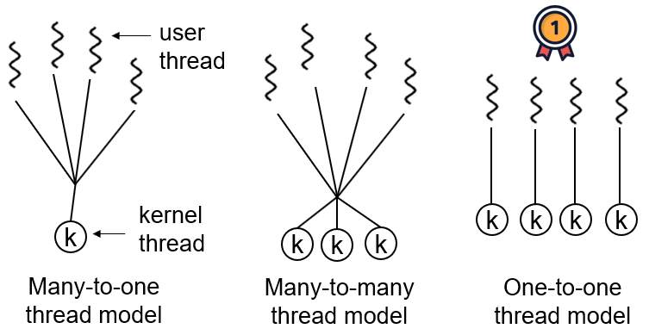
Multithreading models

Slide 9
How are OS and kernel related?
An Operating System is a software which contains different programs in it, and the Kernel is one of them.
The Kernel is a programs which is close to the hardware of the system and so, it performs all the tasks of the operating systems which involve a link between both the hardware and the user level applications.
The Kernel thus functions at the lowest level of the operating system, performing tasks such as file management, process management, memory management, etc.

Slide 10
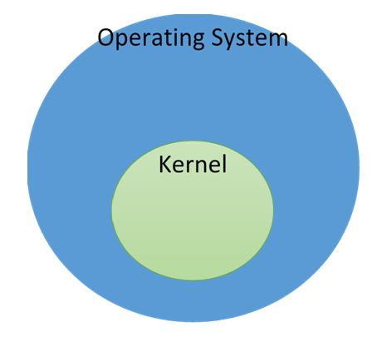

Slide 11
Two modes of operation in the operating system
Every user process operates under the user mode. In this mode, processes do not have direct access to the RAM or other hardware resources and have to make system calls to the underlying APIs to access these resources.
The system starts in the kernel mode when it boots up. The kernel mode has direct access to all the underlying hardware resources. In the kernel mode, all memory addresses are accessible and all CPU instructions are executable.
The mode bit is set to 0 in the kernel mode. The mode bit is set to 1 in the user mode.

Slide 12
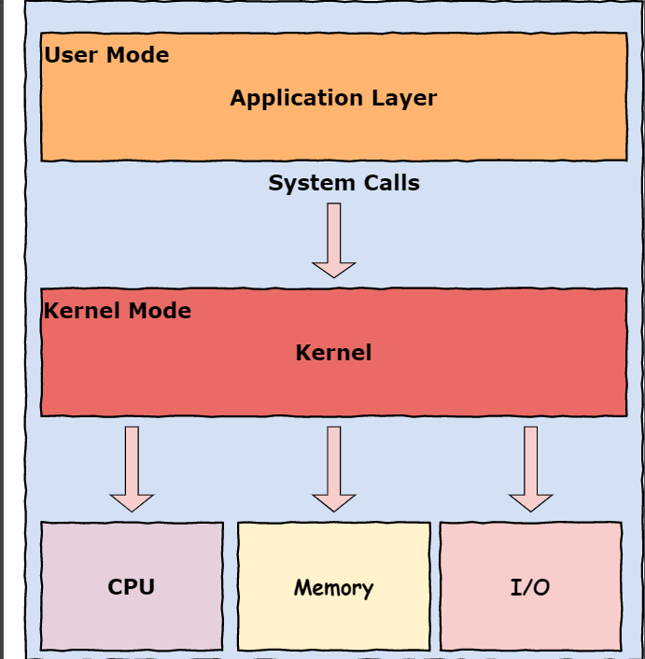

Slide 13
How does the hardware know about the mode of execution ?
In the ordinary course of events, any code you write is 'user mode code’.
Kernel mode code is executed only when you execute a system call and the control jumps from your user code to the operating system.
Obviously, if you're writing kernel code, then things are different — that code will be kernel mode code. But most people most of the time are only writing user mode code.

Slide 14
What is system call?
A system call is a function that a user program uses to ask the operating system for a particular service.
User programmers can communicate with the operating system to request its services using the interface that is created by a system call.
System calls are always carried out in the operating system's kernel mode.

Slide 15
API vs System call
API is used to establish connectivity among applications. It is an interface which takes the requests from the user and informs the system about what has to be done and returns the response back to the user.
System call provides an interface between user program and operating system.
When the user wants to give an instruction to the OS then it will do it through system calls. Or a user program can access the kernel which is a part of the OS through system calls.

Slide 16
System call parameters
On i386, the parameters of a system call are transported via registers. The system call number goes into %eax
the first parameter in %ebx
the second in %ecx
the third in %edx
the fourth in %esi
the fifth in %edi
the sixth in %ebp
Sysenter and Sysexit are used to enter and exit a system call (Pentium II microprocessor)

